Slide 1
SOCIAL Q & A
By
Siva sai Krishna

Slide 2
INTRODUCTION
The Internet is an important source of information, where the amount of data is vast and constantly growing.
Users rely on search engines to find specific information in this knowledge base.
Search engines such as Google and Bing use keywords provided by the users to perform searches.
Recently, industrial research and development activities, such as Microsoft and Facebook’s social-featured Bing search endeavor, try to combine search engines and online social networks for higher search performance.

Slide 3
WHY SOCIAL Q & A
Question and Answer (Q&A) systems play a vital role in our daily life for information and knowledge sharing.
Users post questions and pick questions to answer in the system.
Due to the rapidly growing user population and the number of questions, it is unlikely for a user to stumble upon a question by chance that (s)he can answer.

Slide 4
System Requirements
Project Hardware Requisites
Processer : Any Update Processer
Ram : Min 1 GB
Hard Disk : Min 100 GB
Speed : 1.1 GHz
Minimum Software requisites For Project Development
Operating System : Windows family
Technology : Java (1.7/1.8)
Web Technologies : Html, Html-5, JavaScript, CSS.
Web Server : Tomcat 7/8
Server side Lang : J2EE
Database : My SQL5.5
UML : Star UML

Slide 5
System Design
Our System Design has divided into three types like :
GUI Designing,
UML Designing,
Data base design

Slide 6
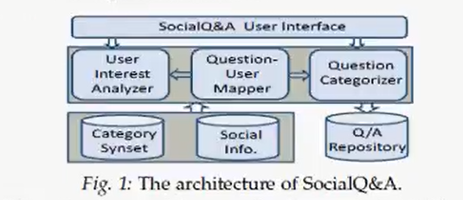
Architecture of Social Q&A

Slide 7
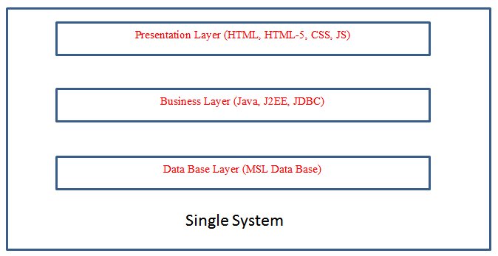
Detailed Structure:

Slide 8
Functional Requirements
User Sign up
User Login
Social Q&A Login
Queries
My Queries
Friend Request
Friend Search

Slide 9
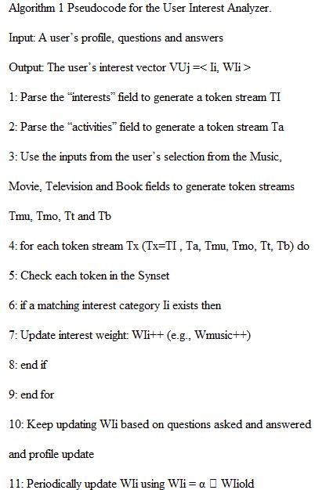
Algorithm used :

Slide 10
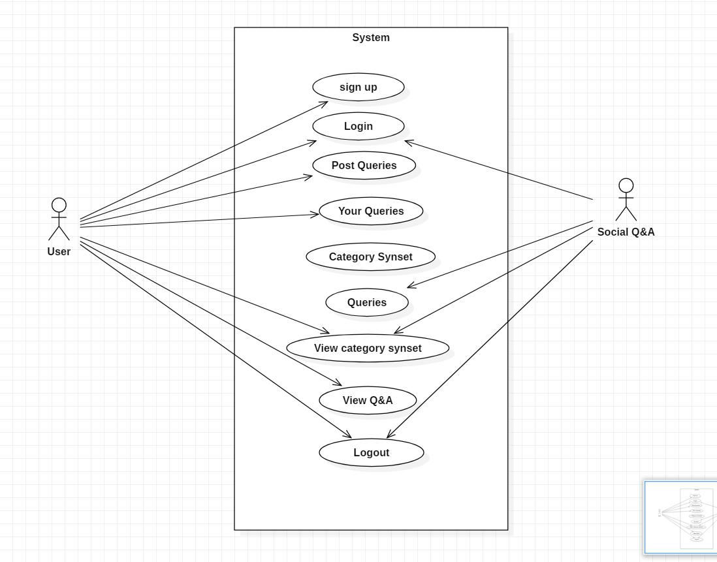
Design process : Use case Diagram

Slide 11
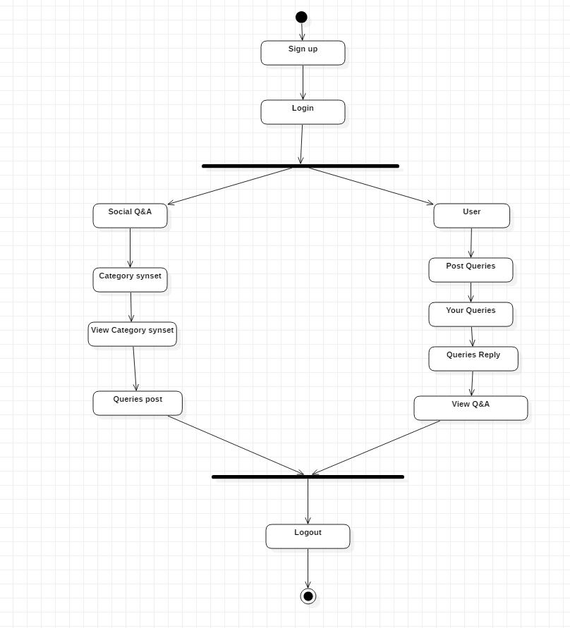
State Chart Diagram:

Slide 12
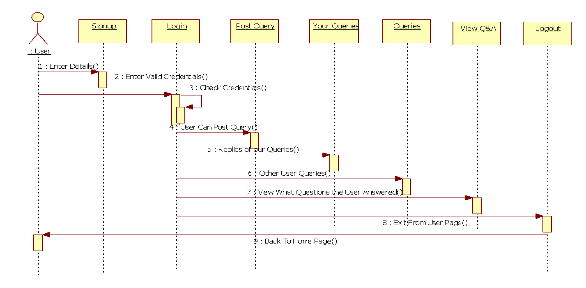
Design process : Sequence Diagram

Slide 13
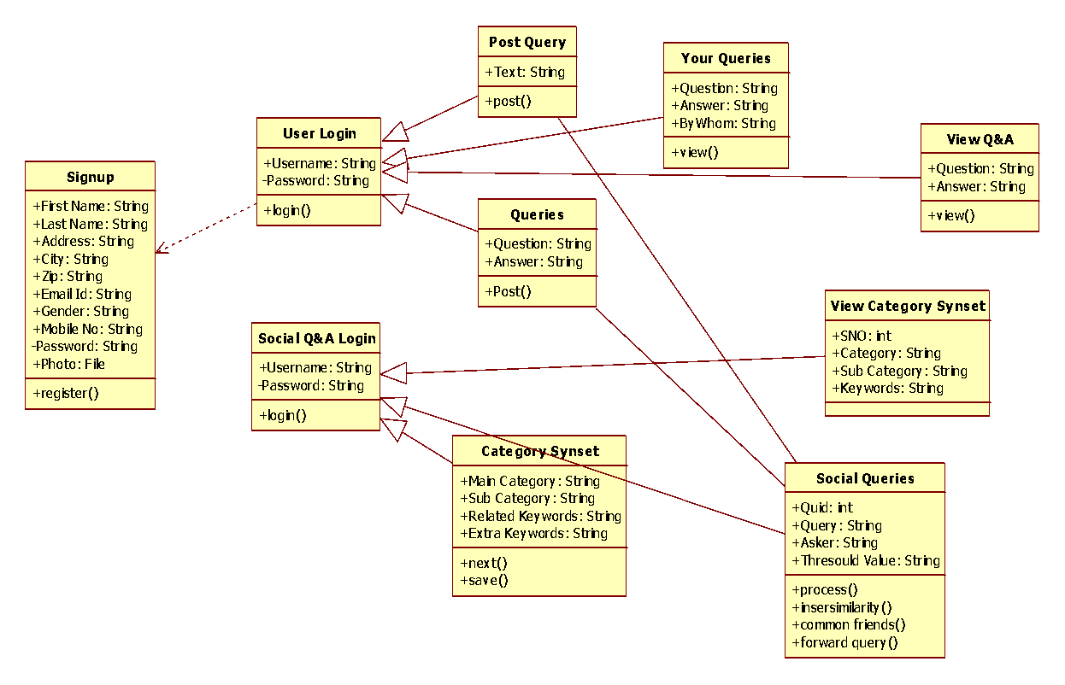
Design process: Class Diagram

Slide 14
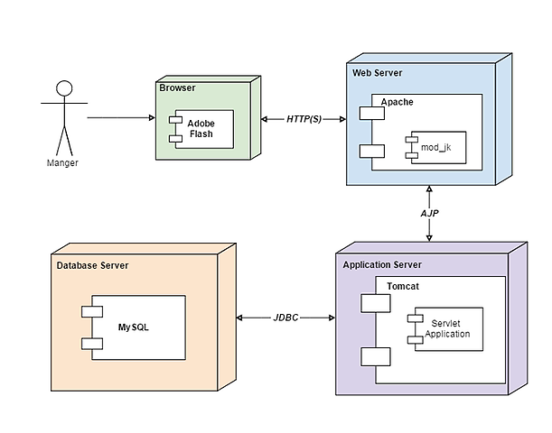
Design process : Deployment Diagram

Slide 15
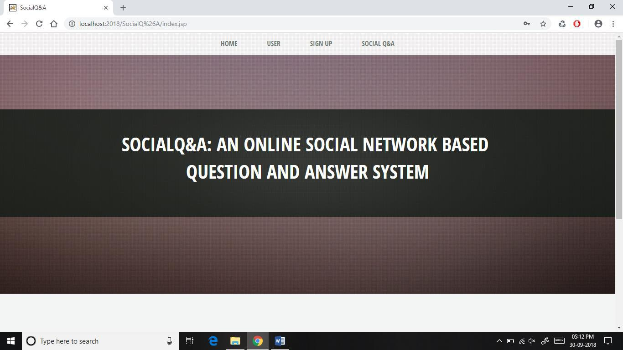
Output Screens:

Slide 16
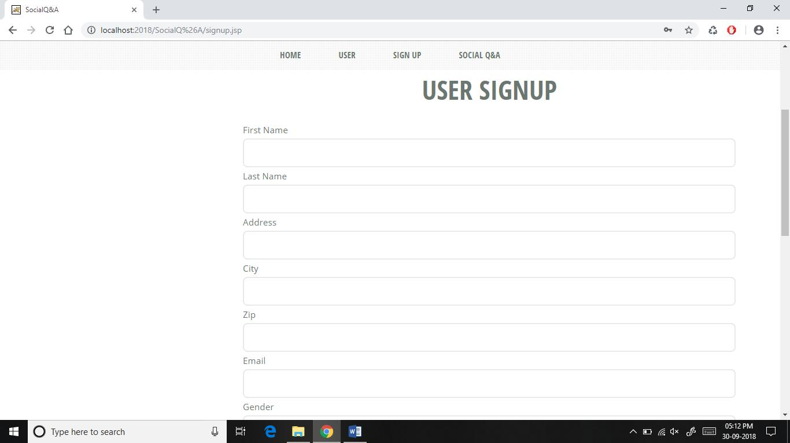

Slide 17
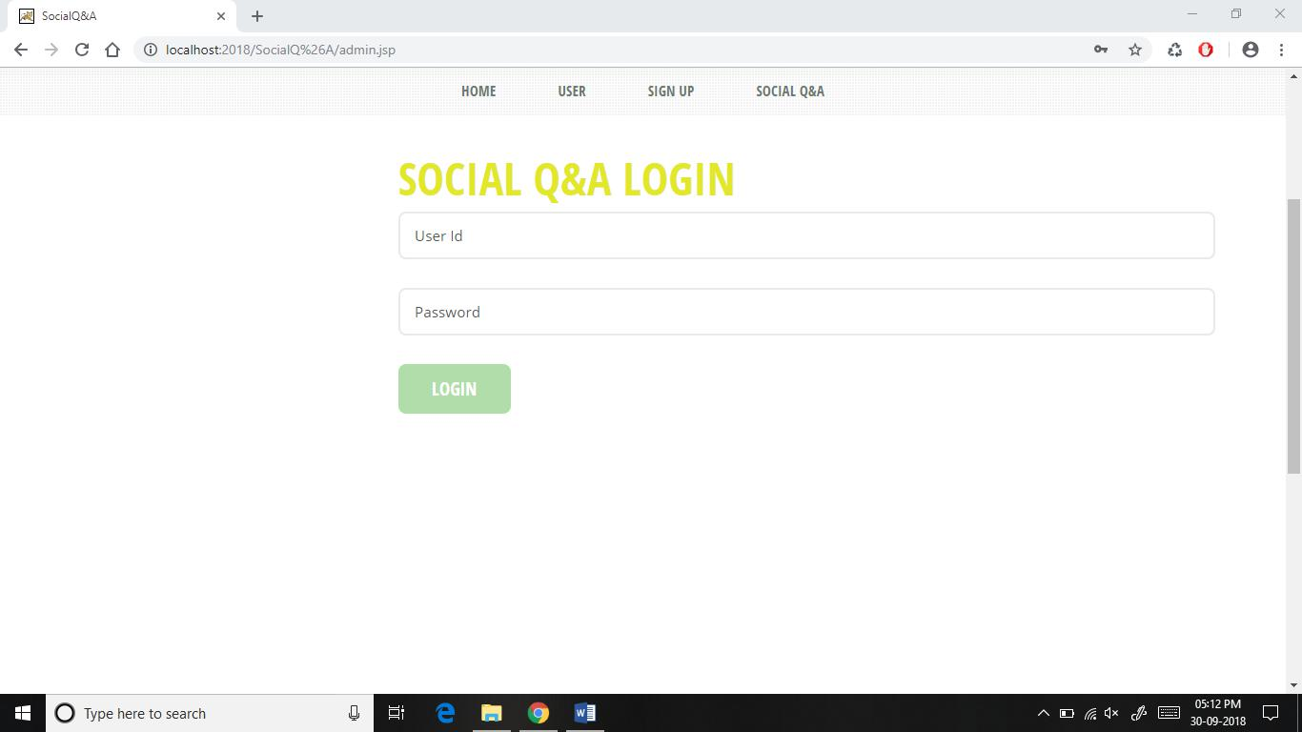

Slide 18
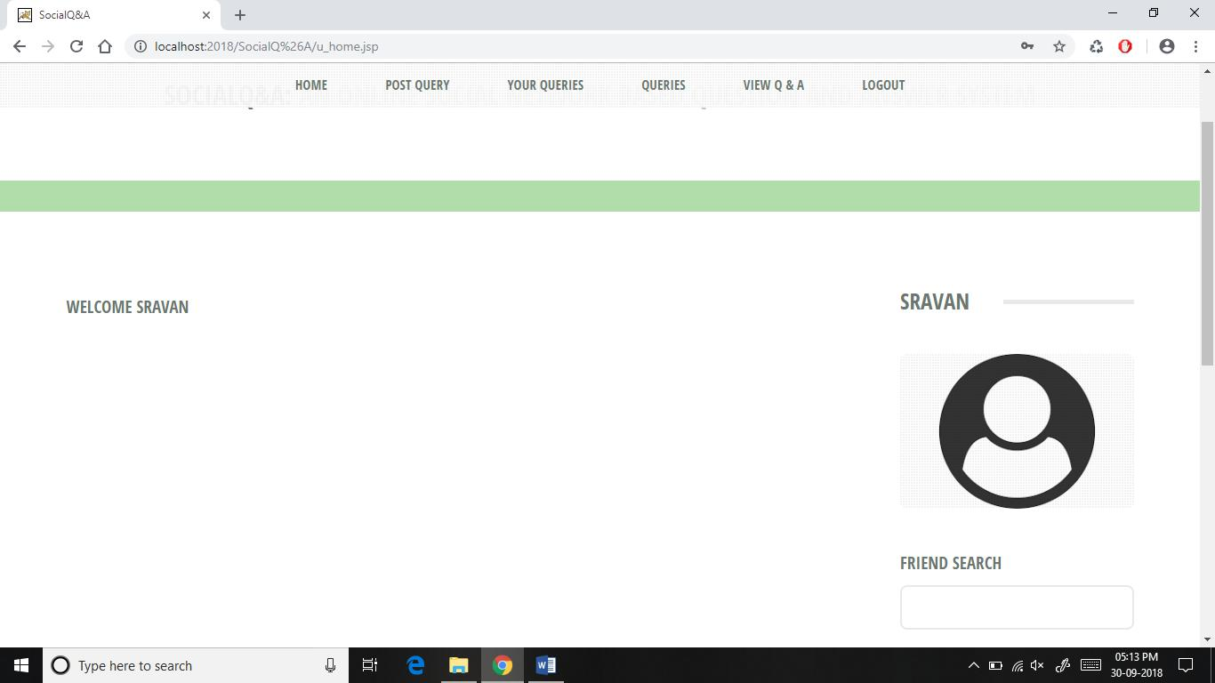

Slide 19
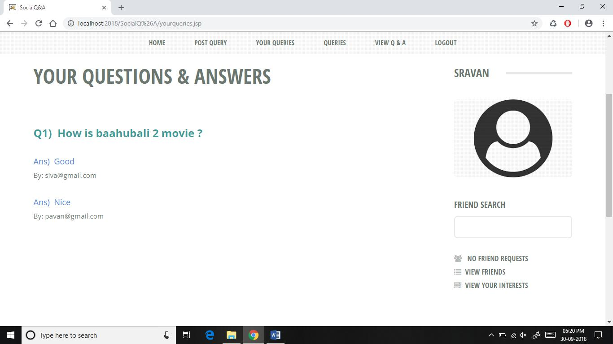

Slide 20
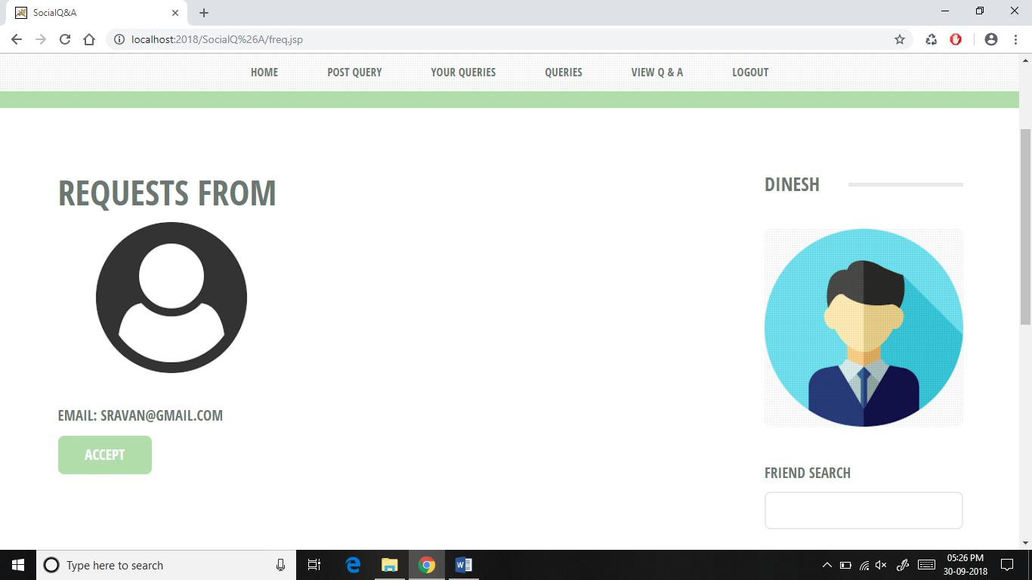

Slide 21
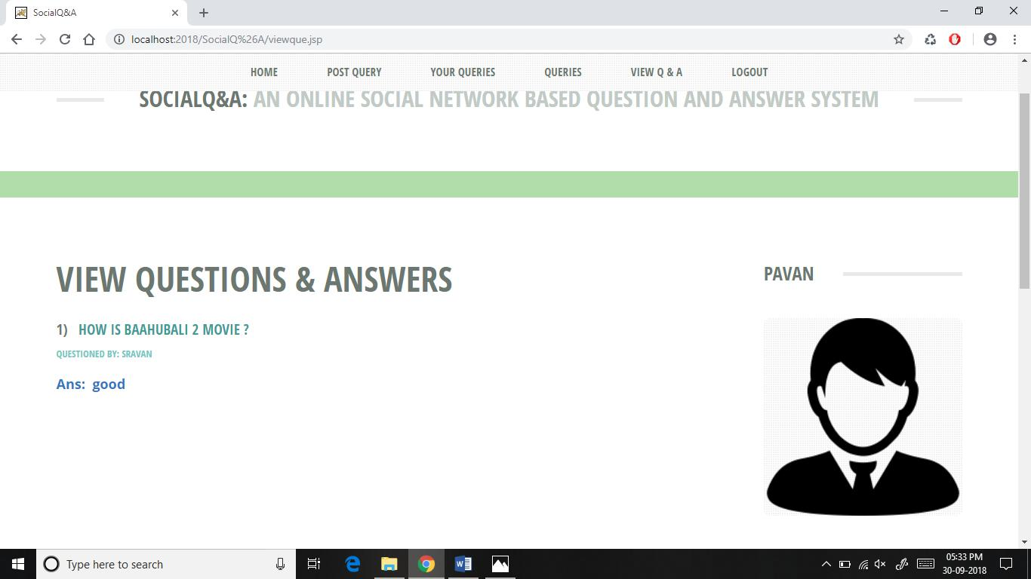

Slide 22
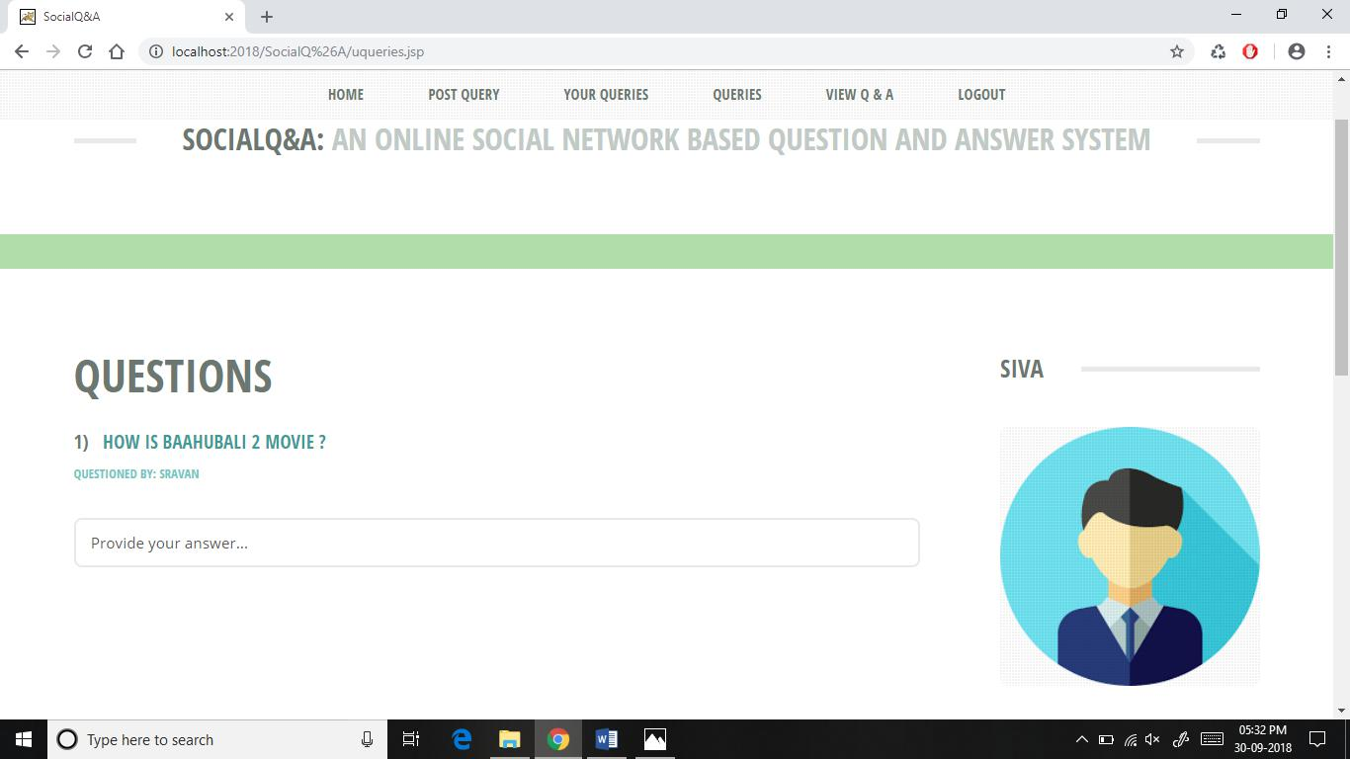

Slide 23
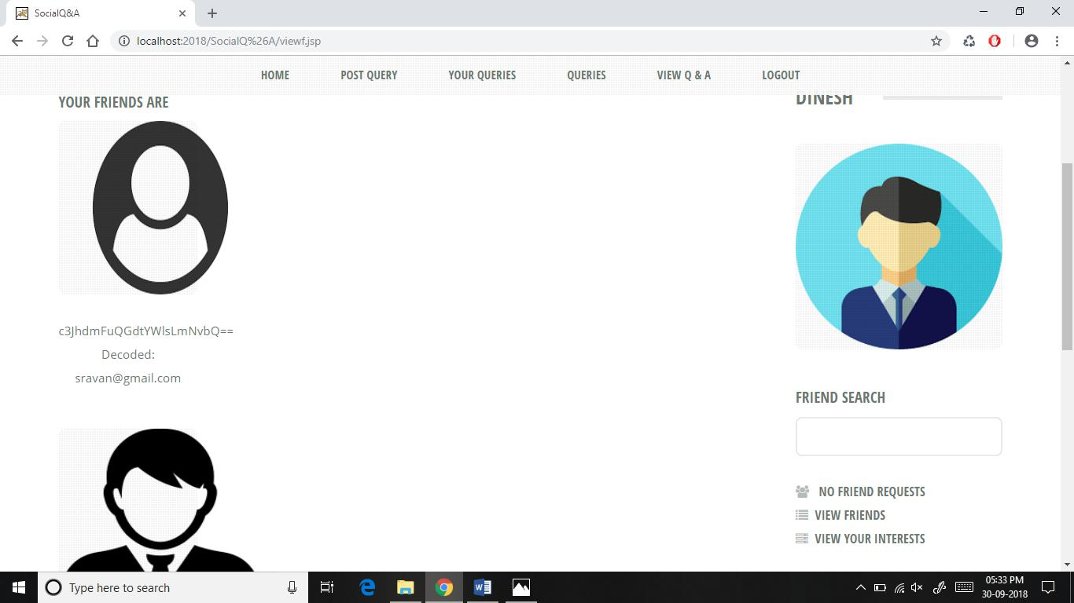

Slide 24
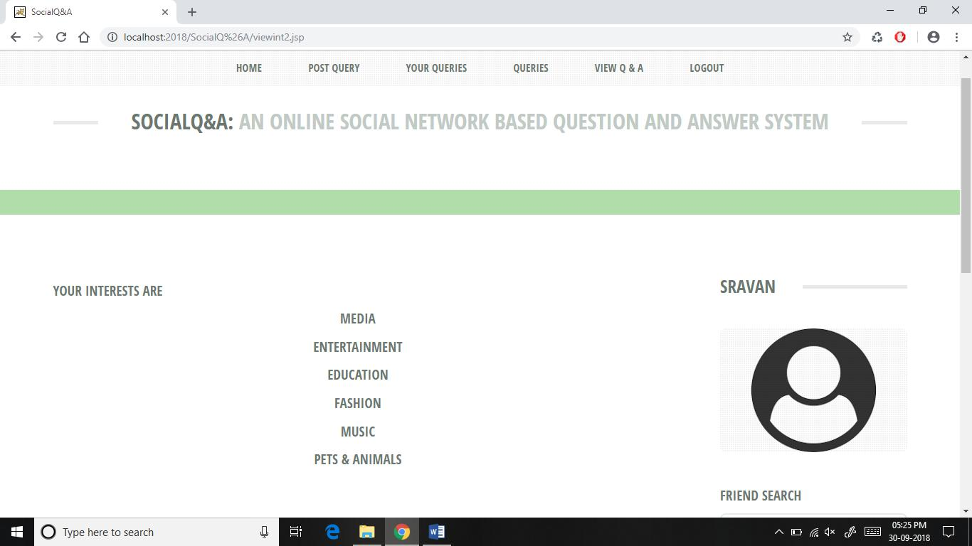

Slide 25
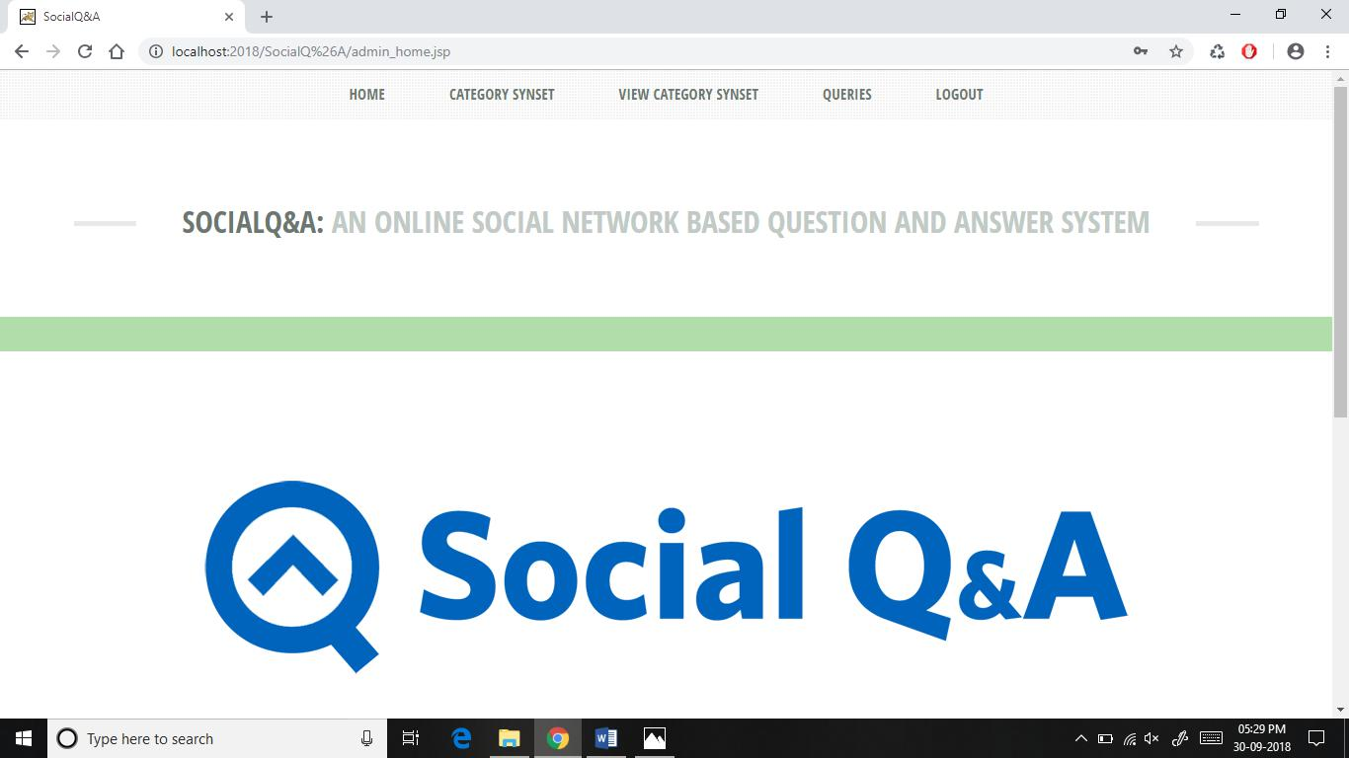

Slide 26
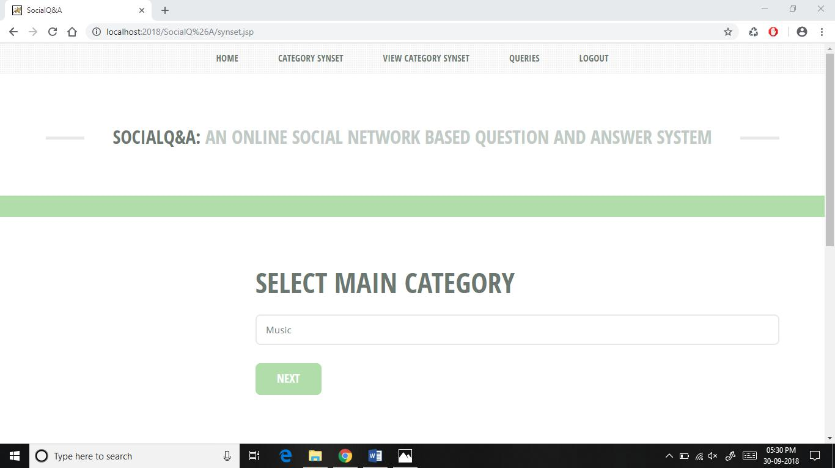

Slide 27
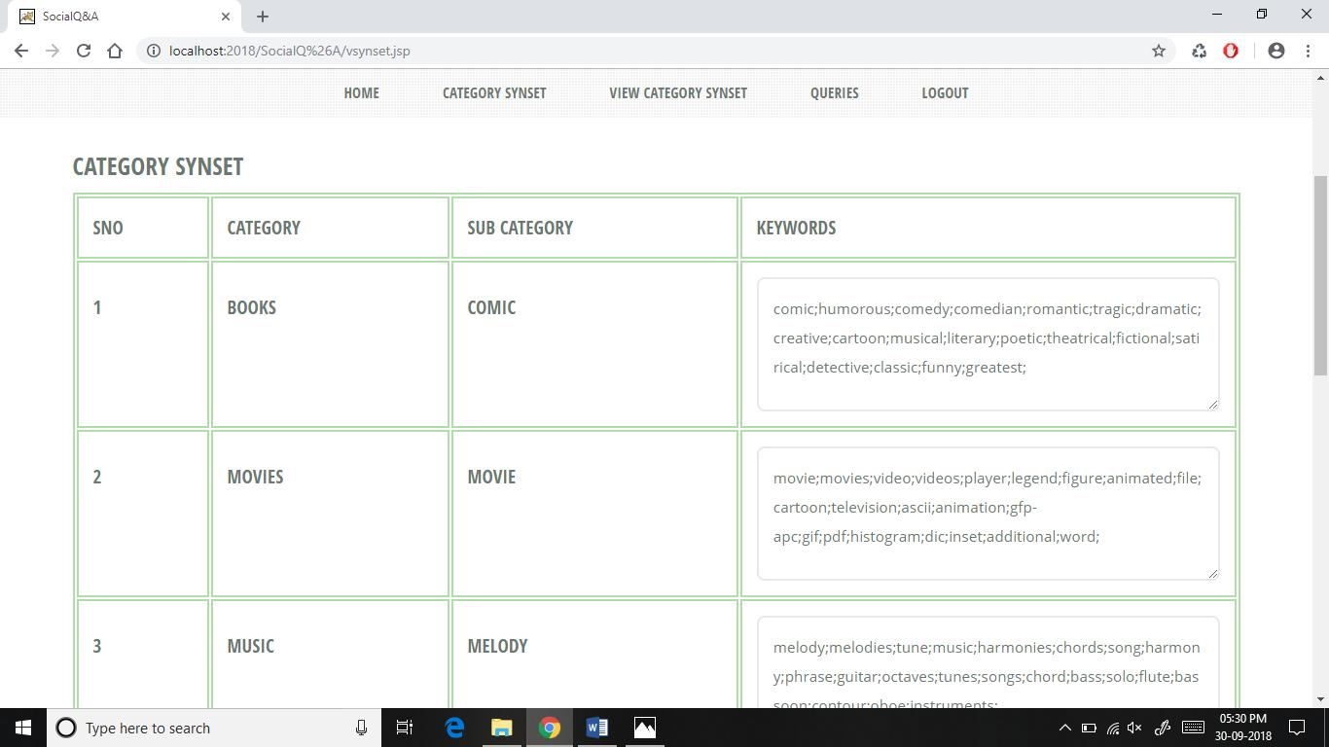

Slide 28
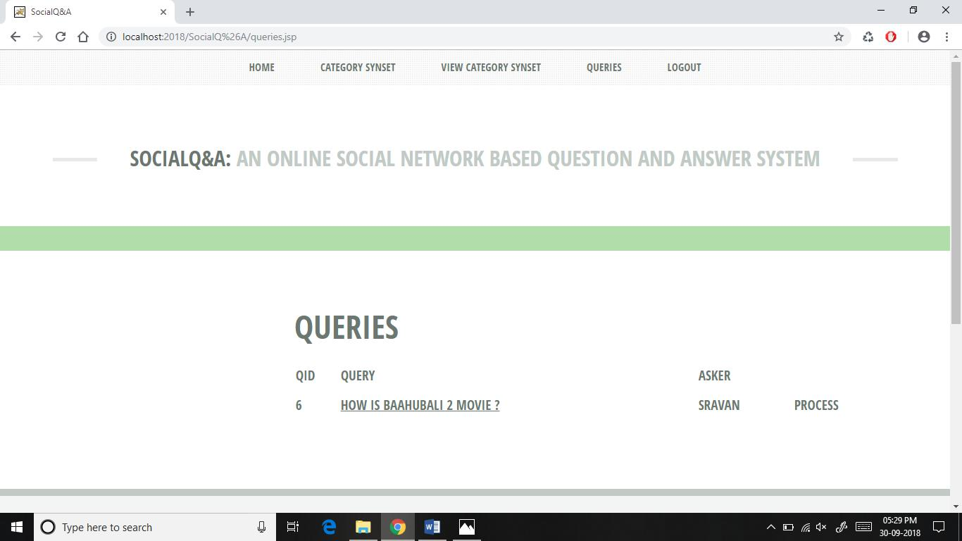

Slide 29
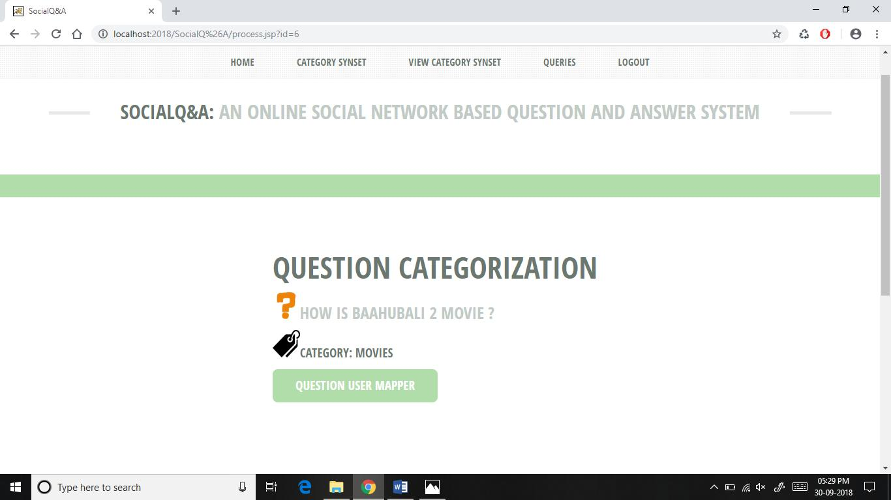

Slide 30
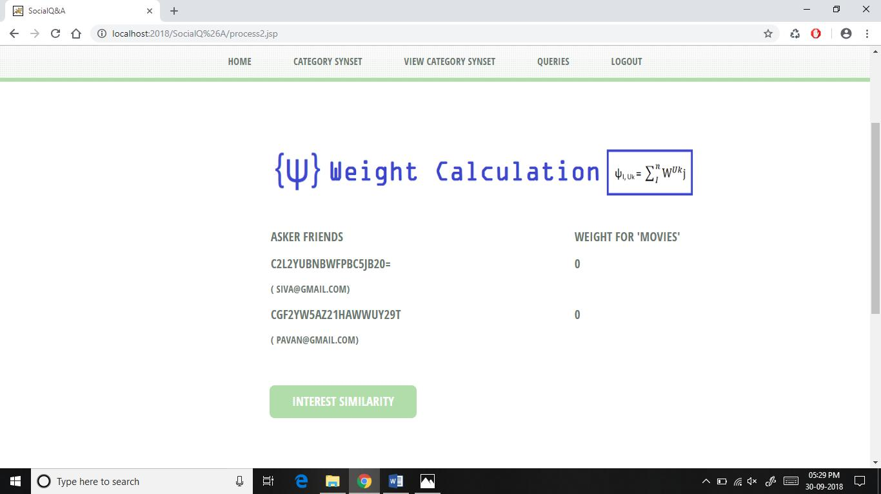

Slide 31
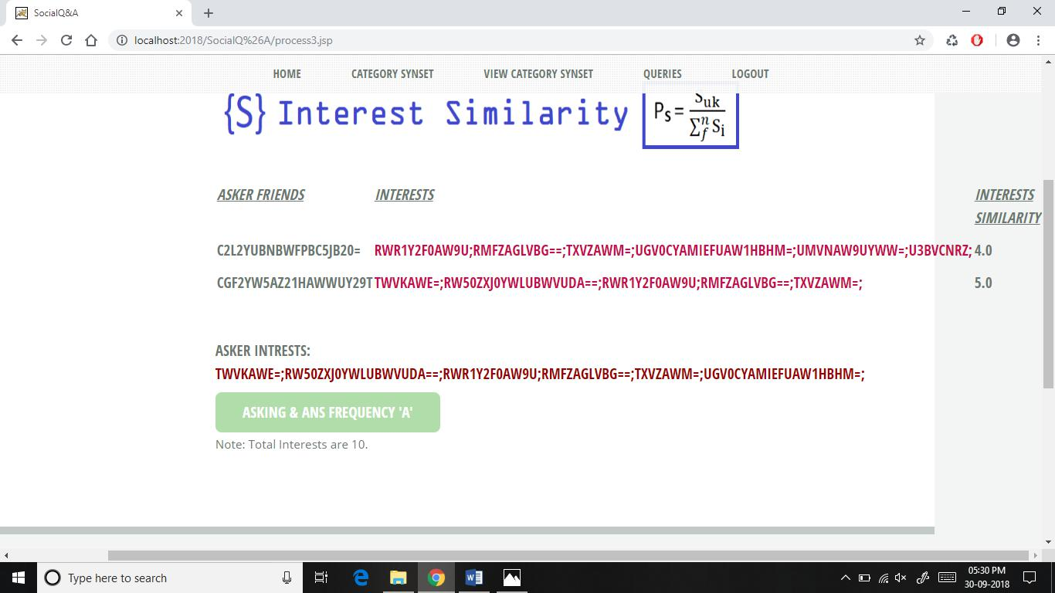

Slide 32
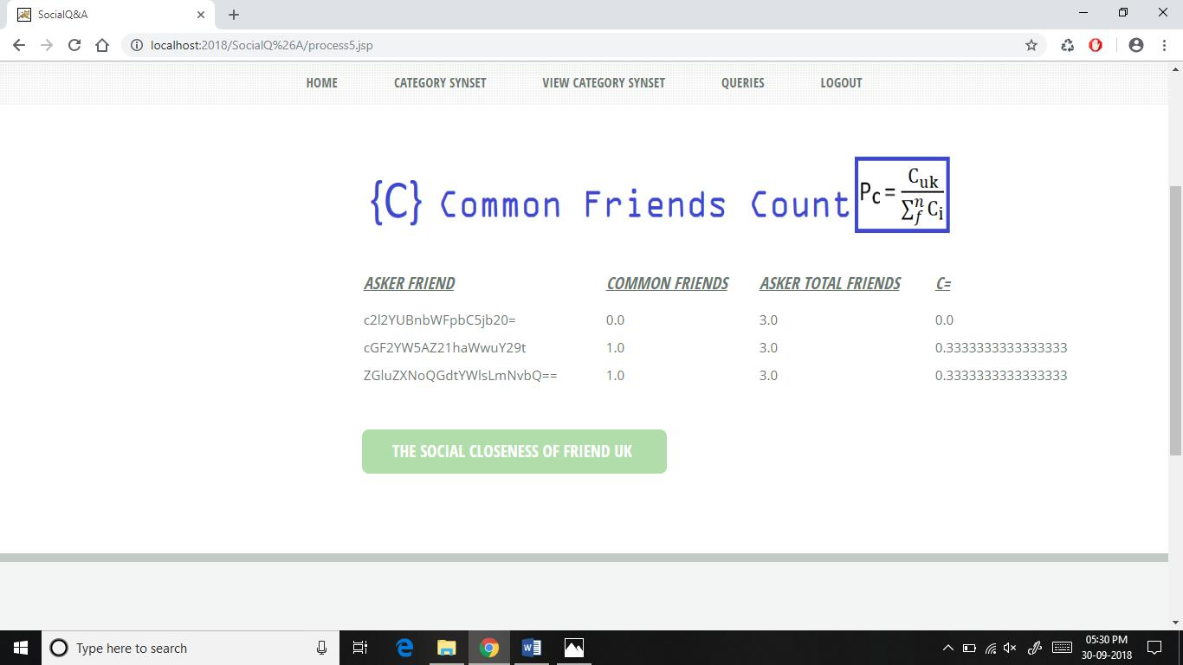

Slide 33
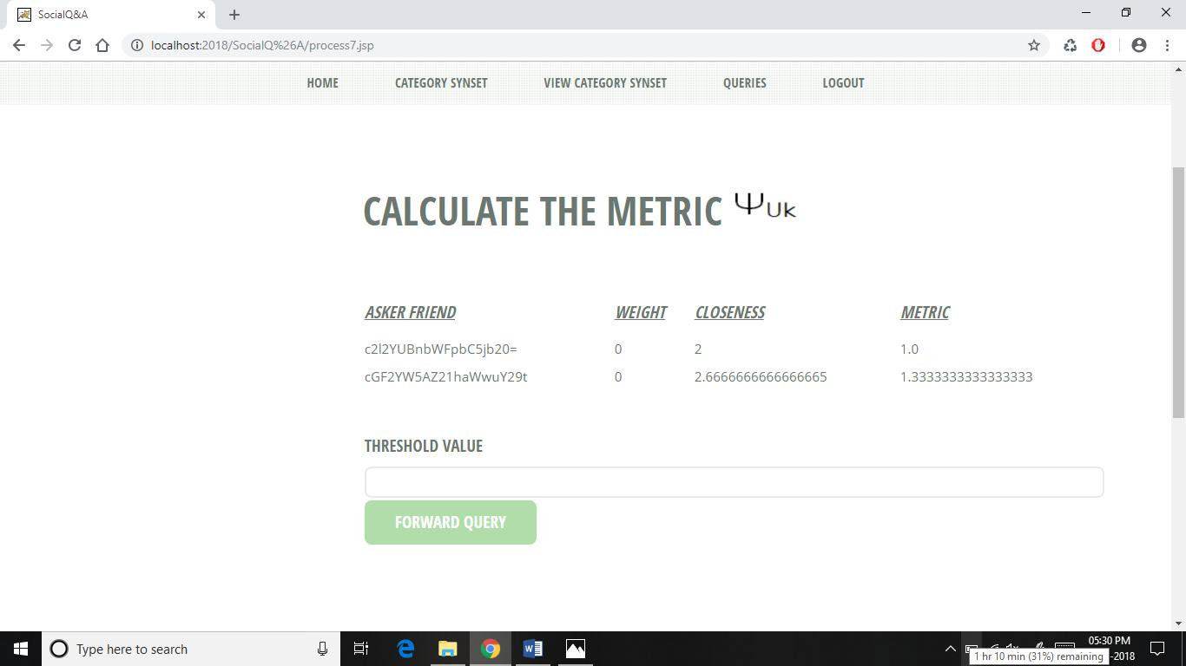

Slide 34
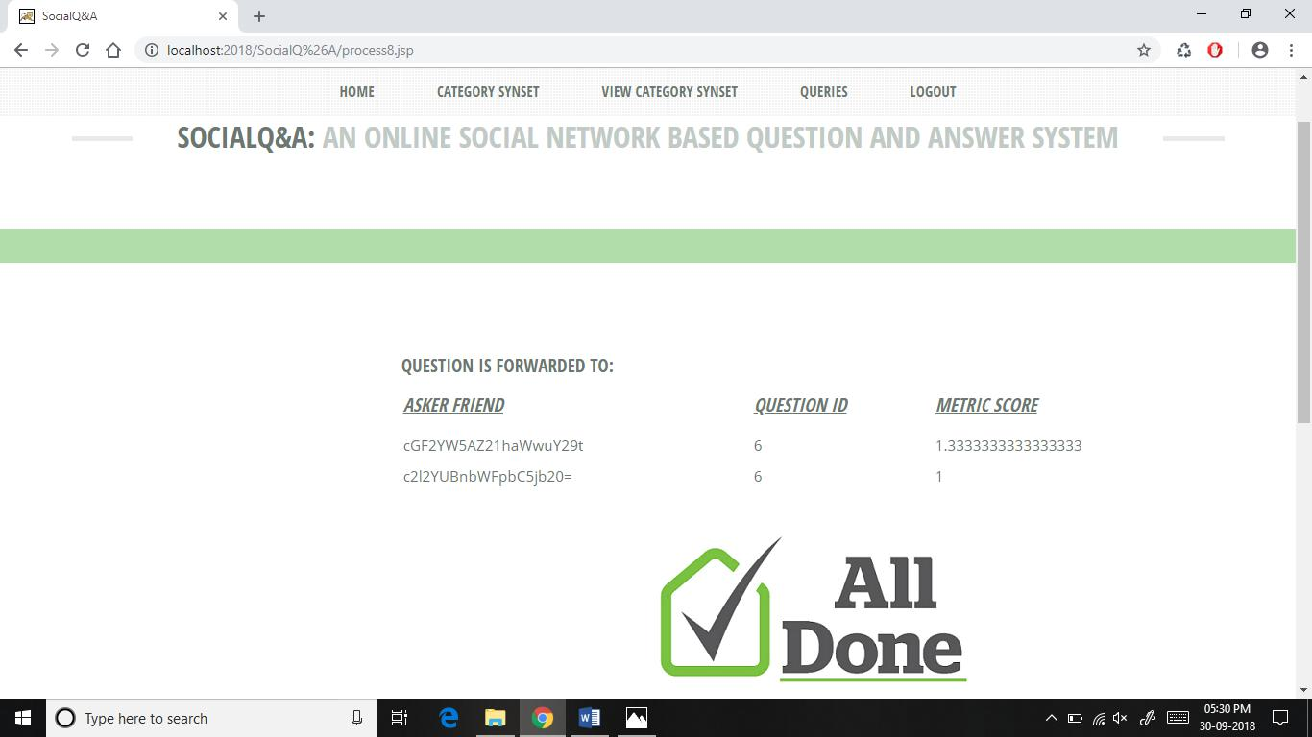

Slide 35
References
[1] M. R. Morris, J. Teevan, and K. Panovich. A Comparison of Information Seeking Using Search Engines and Social Networks. In In Proc. of ICWSM, 2010.
[2] M. R. Morris, J. Teevan, and K. Panovich. What do People Ask Their Social Networks, and Why?: A Survey Study of Status Message Q&A Behavior. In Proc. of CHI, 2010.
[3] Z. Gyongyi, G. Koutrika, J. Pedersen, and H. Garcia-Molina. Questioning Yahoo! Answers. In Proc. of QAWeb, 2008.
[4] Yahoo!Answers Team. Yahoo! Answers BLOG. http://yahooanswers.tumblr.com/, [Accessed on 10/20/2014].

Slide 36


